Slide 1
Exploratory Data Analysis Retail Sales Data
Name : Abhinav Nimje
Cohort : July 2020
Dataset Source : Kaggle
Term : Term 1 & 2

Slide 2

Introduction
Study is on Data Visualization for Retail Sales Data.
Company Contains different types of Stores (Small, Medium, Big) based on location/City type.
Company is service provider of daily needs and other food products.
Given Dataset also contains sales data for the respective store.

Slide 3
Problem Statement & Scope
With the sales mentioned for each store, we need to identify most consumed product.
Which store needs maximum attention to generate good sales.
Food Fat content.
How well older stores are performing.
Also Company needs to identify keys Stores which are generating maximum revenue.
Scope of Study:
Only 1559 odd products are included in study.
Item Visibility factor will play important role so that Customers can notice those.
Stores opened during 1985 to 2009 are considered.
Key Store location.
Store wise sales.
Identify Maximum revenue generating Stores.

Slide 4
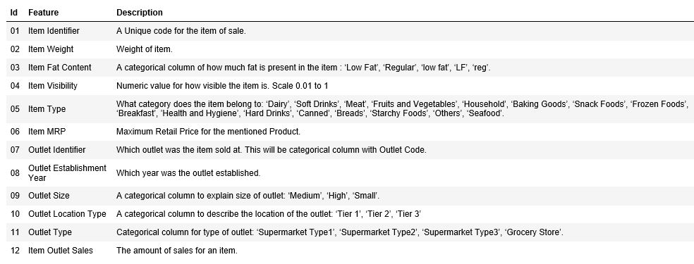
Data Description

Slide 5
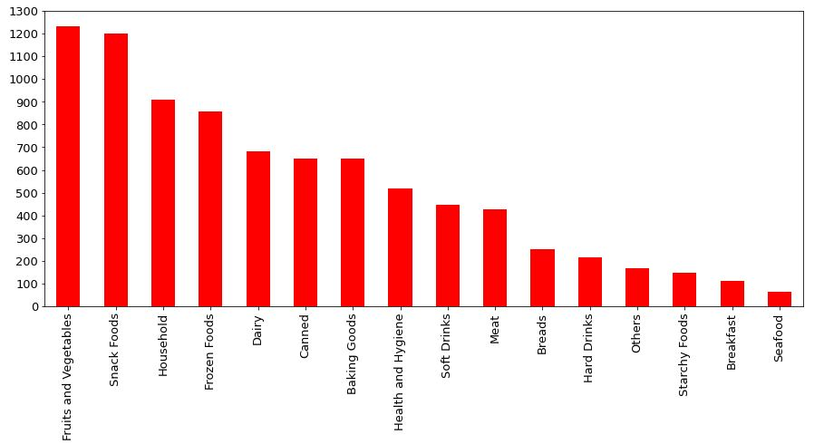
What all Item Type are sold and Which are top 3?
Top 3 Item Types which are maximum sold: Fruits and Vegetables, Snack Foods, Household

Slide 6
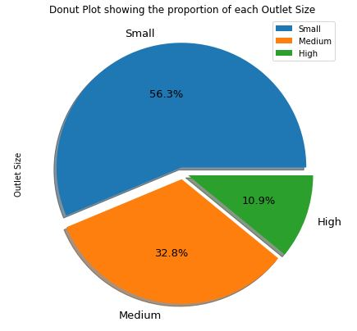
What is maximum Outlet Size proportion?
More than 55% of stores are Small in Size.

Slide 7
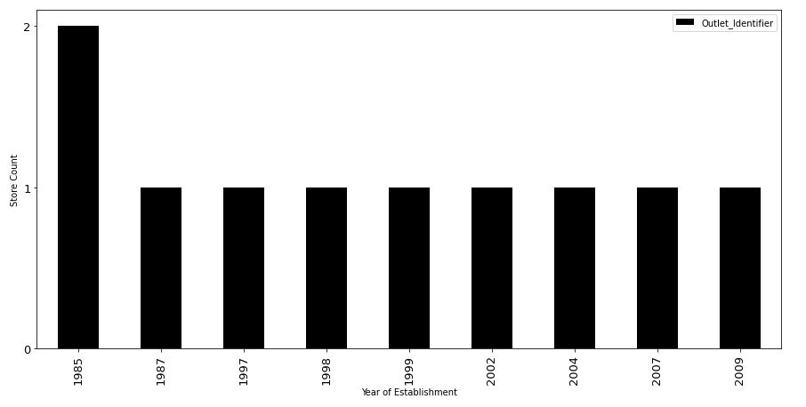
How many Stores are opened each year?
Organization has opened 2 stores in 1985. After that One Store is opened in any given year. Also no new stores are opened after 2009.

Slide 8
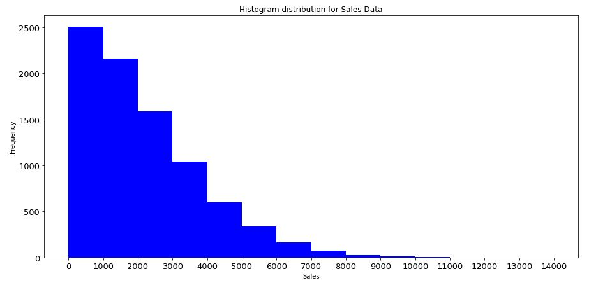
What is trend of year wise sales?
Organization Sales looks positively Skewed. 75% of Sales data is in the range of 0 to 3500.

Slide 9
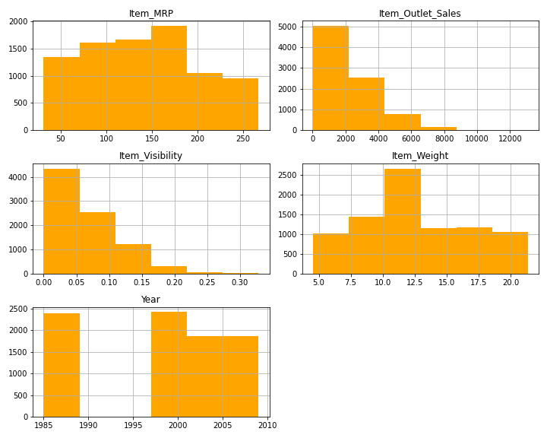
What is the range of each numeric field?
Maximum product price ranges between 75 to 180.
Around 7500 products contributes to Sales in the range 500 to 4000.
Around 4500 products are in low visibility area.
More than 2500 products are in weight range 10 to 12.5.
No Stores opened during 1988 till 1996

Slide 10
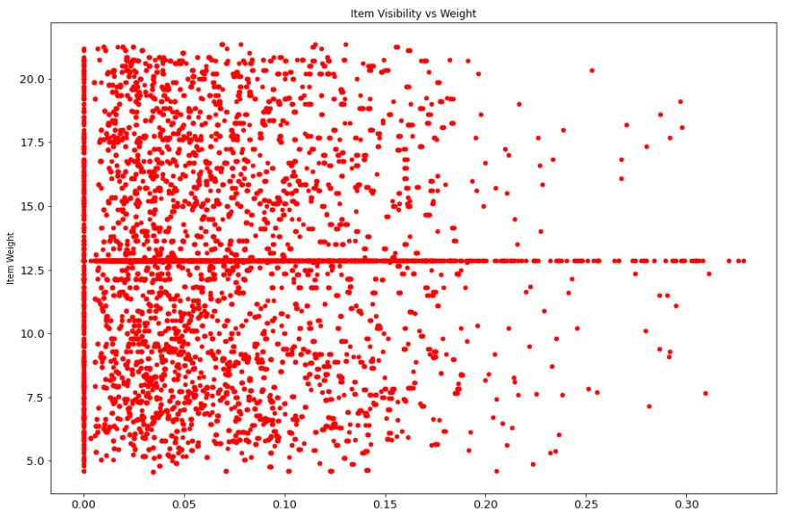
What is Item Weight to Visibility density?
Around 75% Item weights are in 0 to 0.10 visibility range.

Slide 11
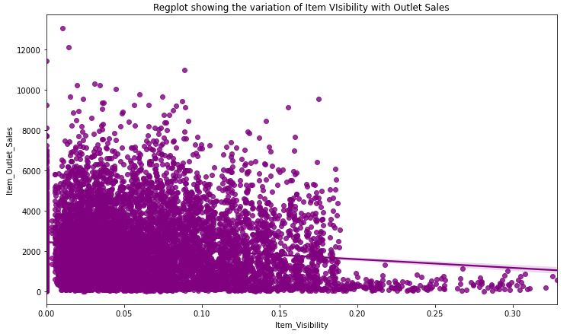
What is Item Visibility to Sales Central Tendency?
Central Tendency of REGPLOT is in the range of Sales amount of around 2000. .

Slide 12
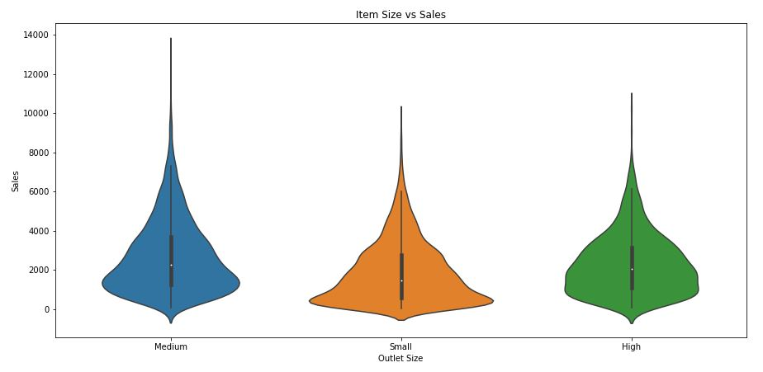
What is Outlet size contribution to sales?
For all 3 types of stores sizes, 75% of sales is till the ranges of 4000.

Slide 13
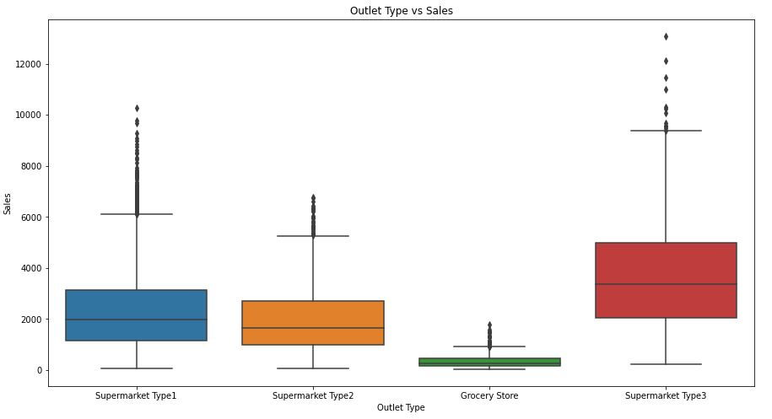
What is Outlet Type contribution to sales?
Grocery Stores are smaller in size hence contributing less to Revenue.
Super Market 1 and Super Market 3 are maximum revenue generating. Reported more than 10000 in several Instances.
Avg. Sales: SM1 : ~2000
SM2 : >1800 & < 2000
SM3 : ~4000

Slide 14
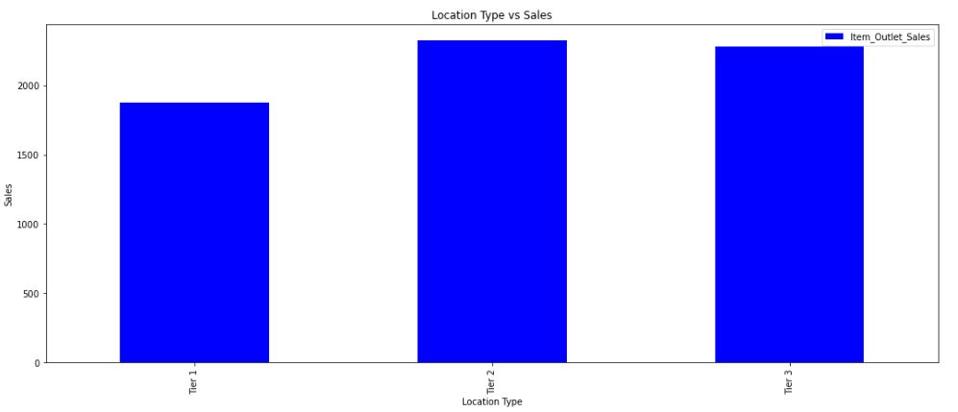
What is average sales per City type?
Average sales of Tier 2 and Tier 3 cities are more than 2000. Whereas Tier 1 in less than 2000.

Slide 15
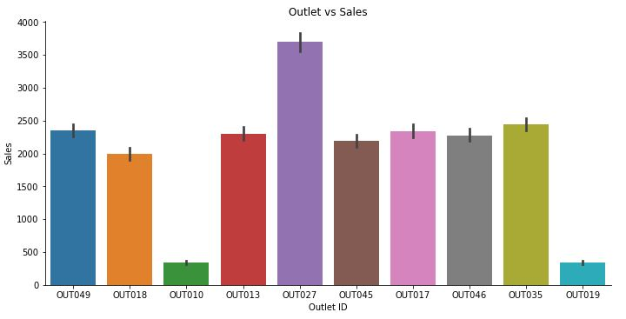
What is average sales per Outlet?
Maximum Sales is contributed by OUT027.
Minimum Sales is contributed by OUT010 and OUT019 which is less than 500.
And Rest all outlets are contributing around 2000.

Slide 16
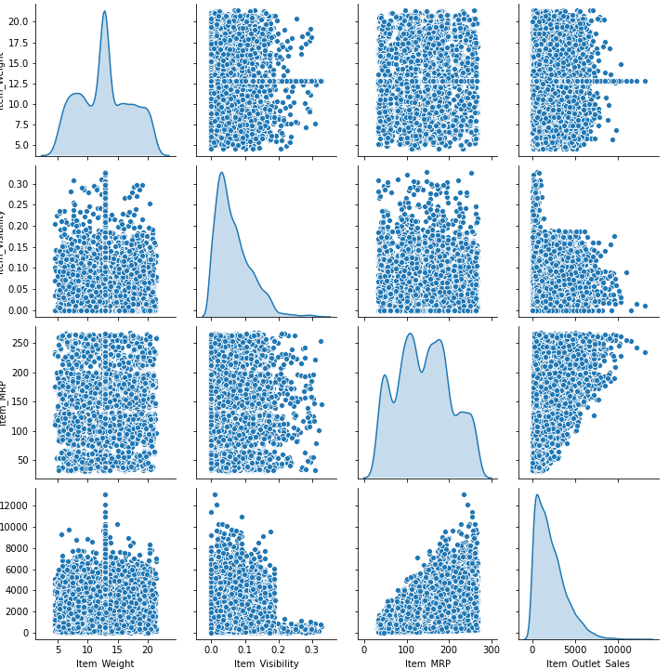
Pair Plot

Slide 17
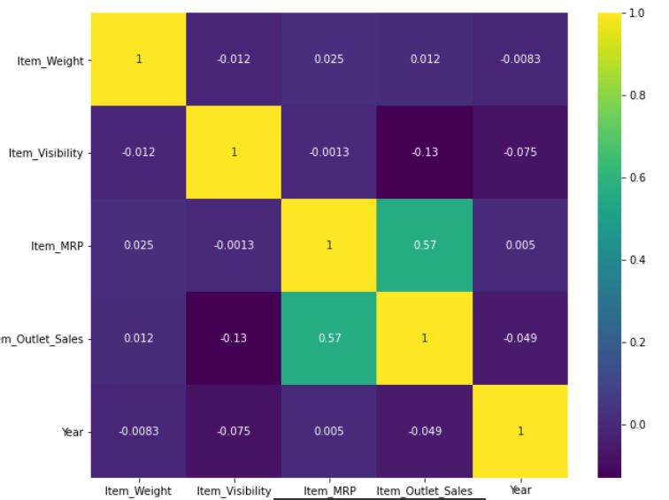
Which are correlated fields?
Maximum correlation found with Item MRP to Outlet Sales.

Slide 18
Conclusions
Top 3 Item Types which are maximum sold: Fruits and Vegetables, Snack Foods, Household
More than 55% of stores are Small in Size.
Organization has opened 2 stores in 1985. After that One Store is opened in any given year. Also no new stores are opened after 2009.
Organization Sales looks positively Skewed. 75% of Sales data is in the range of 0 to 3500.
Maximum product price ranges between 75 to 180.
Around 7500 products contributes to Sales in the range 500 to 4000.
Around 4500 products are in low visibility area.
More than 2500 products are in weight range 10 to 12.5.
No Stores opened during 1988 till 1996
Around 75% Item weights are in 0 to 0.10 visibility range.
Grocery Stores are smaller in size hence contributing less to Revenue.
Super Market 1 and Super Market 3 are maximum revenue generating. Reported more than 10000 few times.
Average sales of Tier 2 and Tier 3 cities are more than 2000. Whereas Tier 1 in less than 2000.
Maximum Sales is contributed by OUT027. Minimum Sales is contributed by OUT010 and OUT019 which is less than 500. And Rest all outlets are contributing around 2000.

Slide 19
Actionable Insights
Company should have opened more stores during 1988 till 1996, which could have been very helpful for maximum revenue generation.
Central tendency shows average sales of 2000 but around 75% products are in 0 to 0.10 visibility ranges which contributes to Maximum share in sales. Company should plan on placing products in right area to increase visibility and in turn increases Sales.
Super Market 1 and Super Market 3 are maximum revenue generating. Super Market 2 is comparatively generating less revenue. Company should focus on opening more Super Market 1 and Super Market 3.

Slide 20


